Slide 1
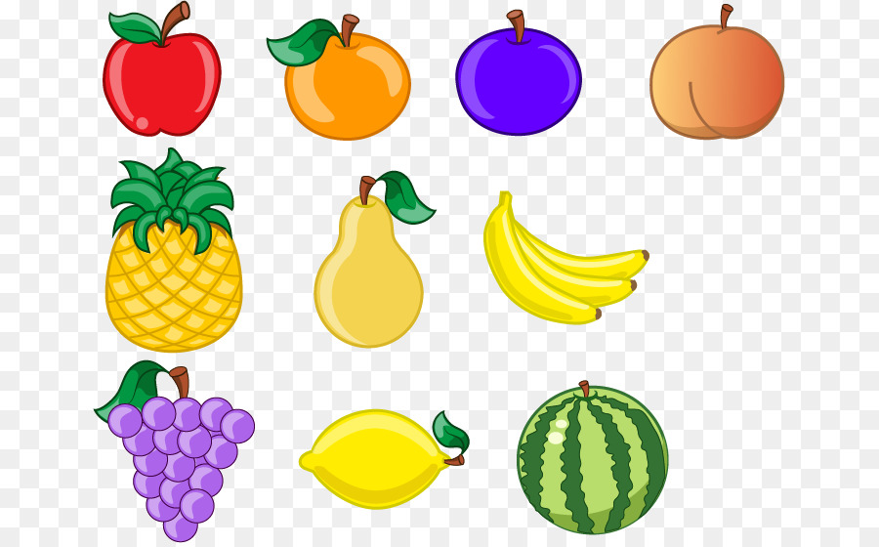
Panda Catcher
Made by Pete studio
Main Creators: Szymon & Krystian

Slide 2
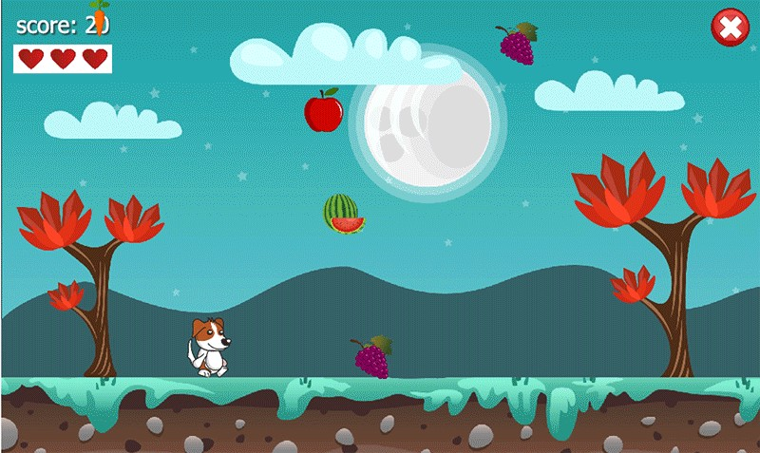
Elevator pitch
You play as a panda that is catching food for himself.
The objective of the game is to catch as much food as possible.
Without dropping any of the food on the ground.
Example game >

Slide 3
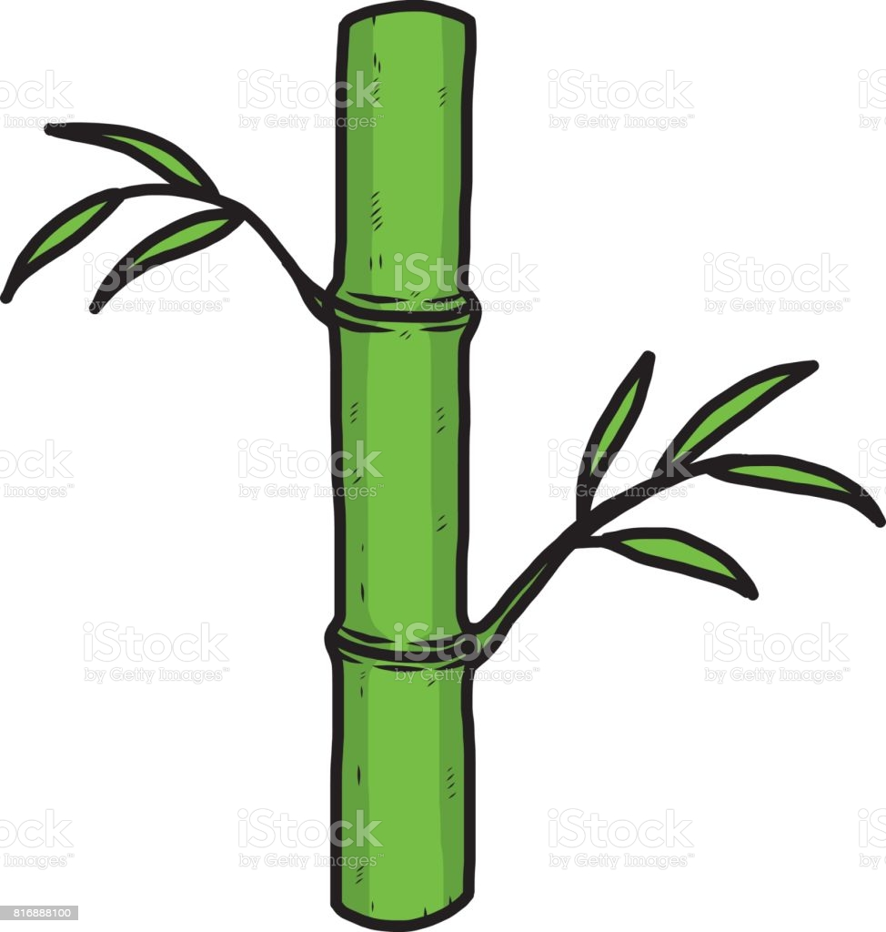
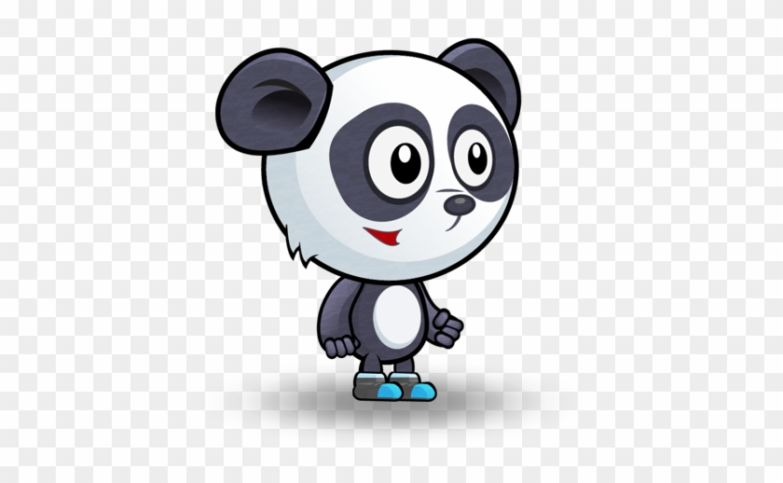


30 seconds gameplay description
The game will feature the player as a panda who will catch bamboo to eat.
But some people decided to throw trash at him, avoid the trash and catch bamboo to eat.
Go trough levels and unlock cosmetics and more levels. The higher level you get to, the harder it gets!

Slide 4
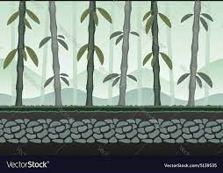
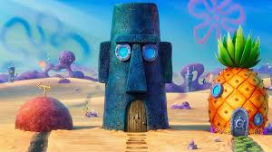
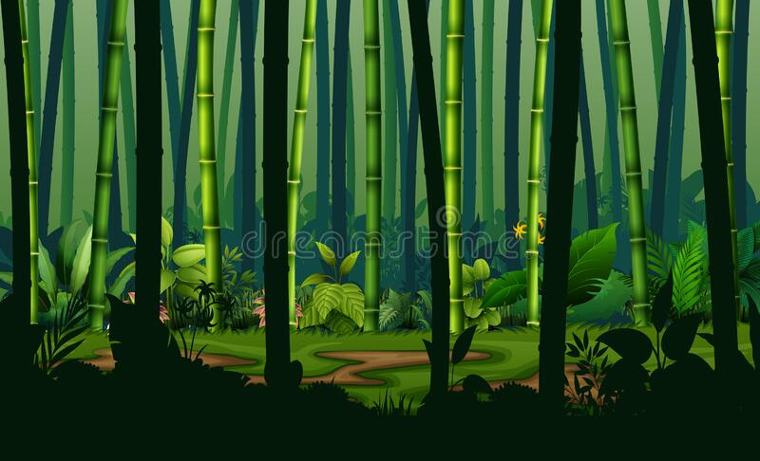
Pillars
The game features beautiful background with fun details in it, each level will be unique from the previous ones, the playable character will be a lovable panda. The game will also test your reflexes to catch the fruits in time

Slide 5

Features
Each level will bring a unique spin on the level and give challenges to the player, the player will also be able to gain equipment from achievements and challenges, which can be used to customise their own panda.
They can unlock cosmetics for the background such as a bamboo plant, or a bird house.

